Slide 1

ALGO UVT Challenge Intro
Chassis & Safety | Passive Safety & Sensorics

Slide 2

Occupant Movement Estimation
Occupant
Movement
Estimation
Optimum Time to Deploy (TTF)
TTF = t
- t
opt
Displacement Occupant*
* Occupant Displacement should not influence bag inflation
Adjustable thresholds defined according to the occupant belt status and compared to the predicted displacement.
Good prediction of occupant displacement enable optimal time for deploy decision.

Slide 3
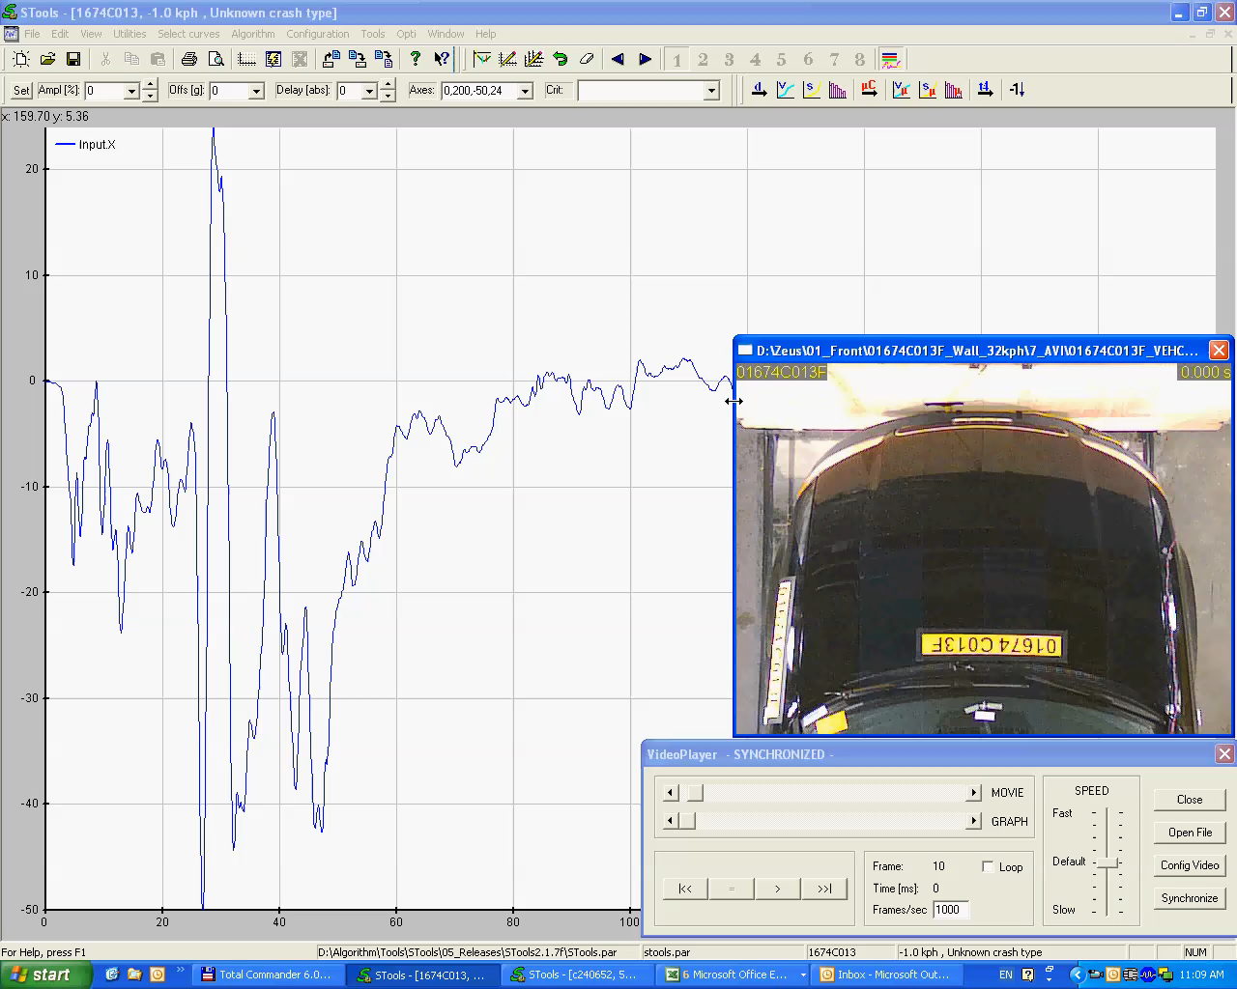

Slide 4
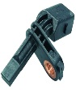
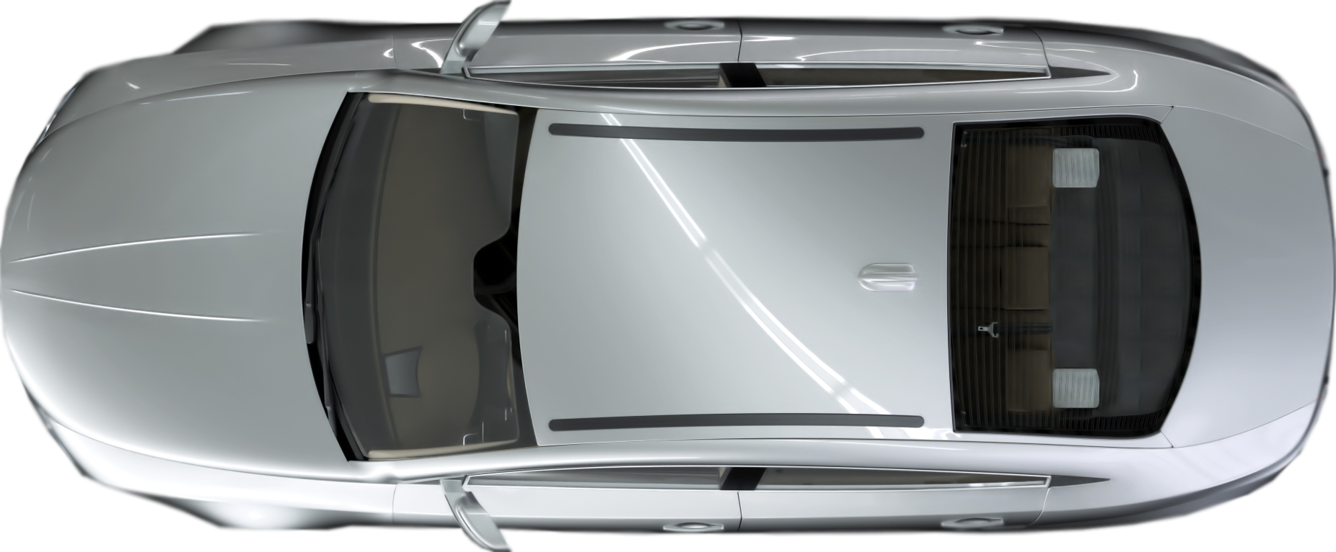
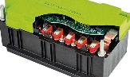

Algorithm Function Premium 2020
11 Passenger pretensioner 13 2nd row pretensioner
23 Buckle pretensioner
24 Sil end pretensioner
25 Load limiter
12 Active headrest
30 2nd row front AB
32 2nd row LL
34 Roll actuator
18 Sidebag 19 Pelvis bag 20 2nd row sidebag 21 Windowbag
8 Airbag stage 1 9 Airbag stage 2 10 Airbag vent
42 3rd row pretenstioner
43 3rd row load limiter
Front & Side Crash Detection
38
33
39
21
20
42
18
19
11
24
25
13
43
12
23
32
8
10
ECU
45
9
Roll Rate
High G
X / Y
30
46
Rear Crash
High Voltage Safety
Front Crash Detection
Pedestrian Protection
High Voltage Safety
47
44
Low g z/y
Pitch
Rate
48
35
29
2
4
6
22
28
3
27
31
40
36
5
15
14
1
26
17
7
41
16
37
34
Front & Side Crash Detection
36 Active Hood
37 Active Hood
38 Active Hood
39 Active Hood
22 Pyro Battery Deploy
35 HV Battery cut off
1 Driver pretensioner 7 2nd row pretensioner
26 Sil end pretensioner
27 Load Limiter
28 Adaptive steering column
2 Airbag stage 1 3 Airbag stage 2 4 Airbag Vent
44 Interaction Bag
5 Kneebag 6 Active Headrest
29 2nd row front AB
31 2nd row LL
33 Roll actuator
14 Side Bag 15 Pelvis Bag
17 2nd row Side Bag
16 Window Bag
40 3rd row pretenstioner
41 3rd row load limiter
pSat
gSat
optional

Slide 5
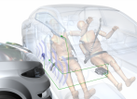
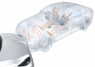
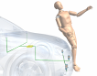

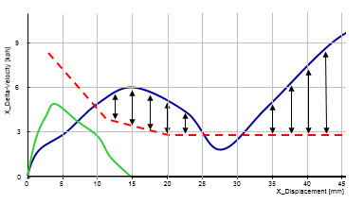
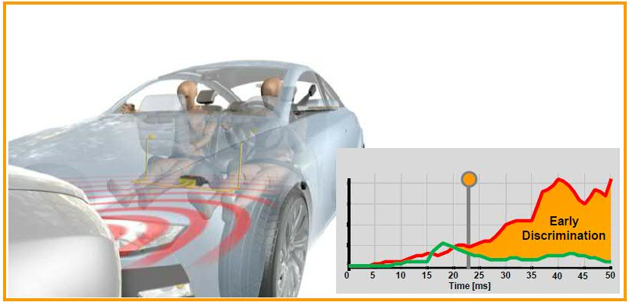
Algorithm Simulation Environment
Front/
Rear
Internal Sensors Satellite Sensors
Algorithm Decisions
ALGO Activation for
Airbag Deployment
Occupant and
Status inputs
Signal pre-processing
Side
Integrated
Safety
Algorithm
OS Interface
Signals Fault for
Crash Recording
Vehicle dynamics inputs
Roll
Pitch
Sensor Status
Surrounding/pre-crash
inputs
Signal Integrity
Diagnostics
PPS
Configuration
Algorithm Judgment of Airbag Deploy Optimum Time for
Passenger Protection

Slide 6

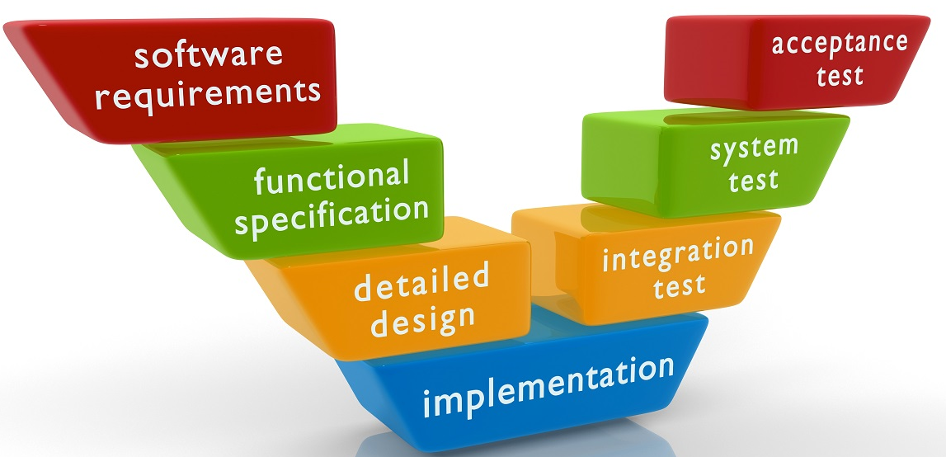


Developer
Focus on features, quality and process
Tester
functional
traceability
integration
architecture
unit

Slide 7






Programming languages / Tools

Slide 8




Workflow
Git commit

Slide 9

What we check in reviews?
Comment your code

Slide 10
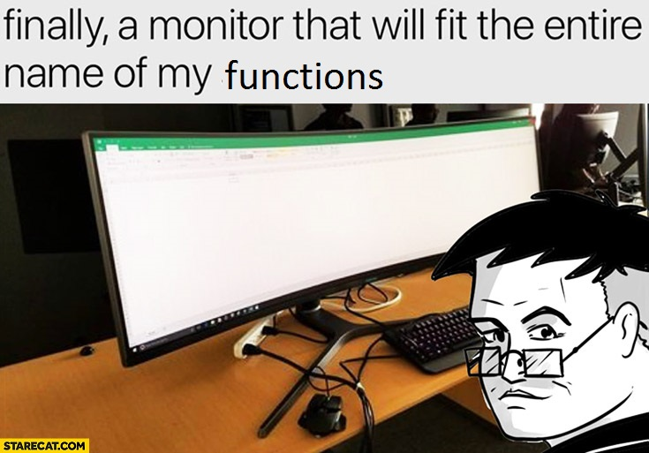
What we check in reviews?
Respect naming conventions

Slide 11
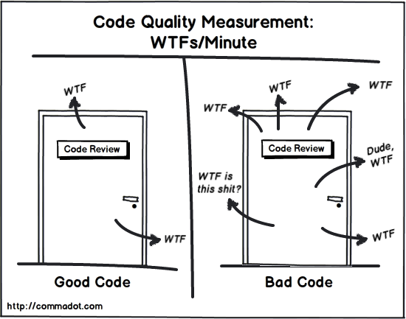
What we check in reviews?
Code should be easy to understand

Slide 12


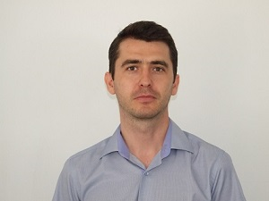
Contact
Adelina Stana – Tool Developer
Email: Adelina.Stana@continental-corporation.com
Gabriel Marin – Algorithm Developer
Email: Gabriel.Marin@continental-corporation.com
Marius Cotuna – Group Leader
Email: Marius.Cotuna@continental-corporation.com
https://github.com/contitimisoara/continental-challenge

Slide 13



